Slide 1
IMAGES & COPYRIGHT
Computing – Faculty of Business, Law and Digital
martin.reid@solent.ac.uk

Slide 2
Correct way of using images in your design work
Create the image yourself
Commission somebody to create the image
Purchased the rights to use an image (royalty free)
The image is in the public domain or Creative Commons
The image is being presented as “fair use” as detailed in copyright law
Notes:
When using images within your work you have a number of options either you have created the image yourself and you own the copyright, you commission somebody else to create the image for you you are using it under a creative Commons or fair use

Slide 3

You created the image yourself
What you create has an automatic copyright even if this is not specified on the work
http://www.copyrightservice.co.uk/copyright/copyright_myths

Slide 4

2. Ask a photographer
You have ask/commission a photographer/artist to create the images for you. (paid or for free)
Image Microsoft clipart

Slide 5
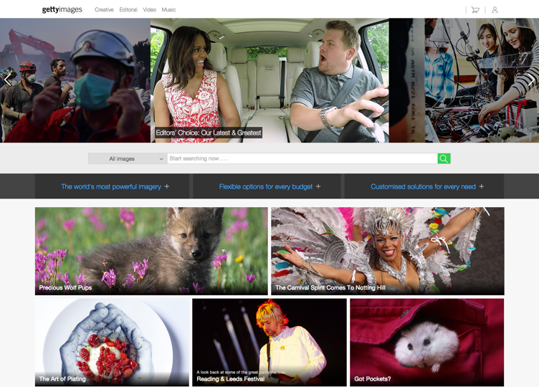
3. Purchase a Royalty Free usage right
Purchase usage rights from a royalty free library. You do not buy the copyright you just buy permission to use the image
Getty Stock Photography
Notes:
Picture libraries all allow you to download and low resolution watermarked image mostly described “composite” or “comp” which you can use in your design work in the planning stage. Once the client has signed off the design you would then pay for usage rights and download the appropriate higher resolution images from the library

Slide 6
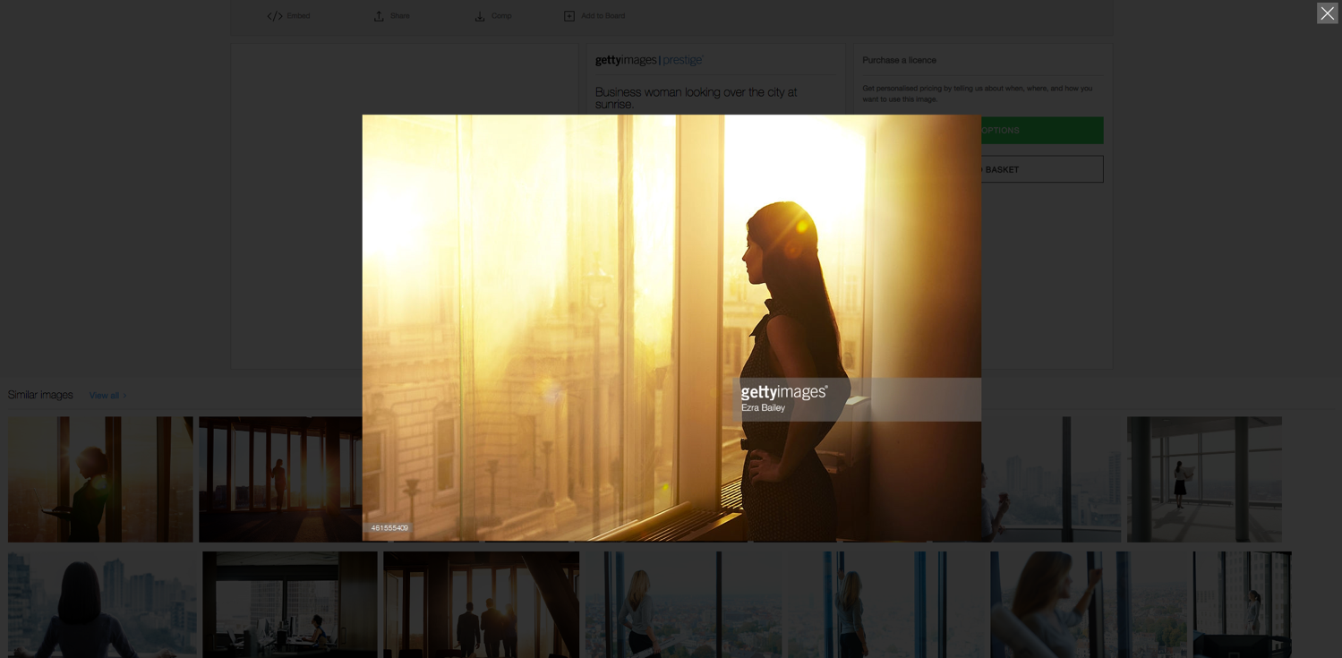

Slide 7

http://www.istockphoto.com/gb
Notes:
There are other cheaper options to purchasing royalty free images such as istock

Slide 8
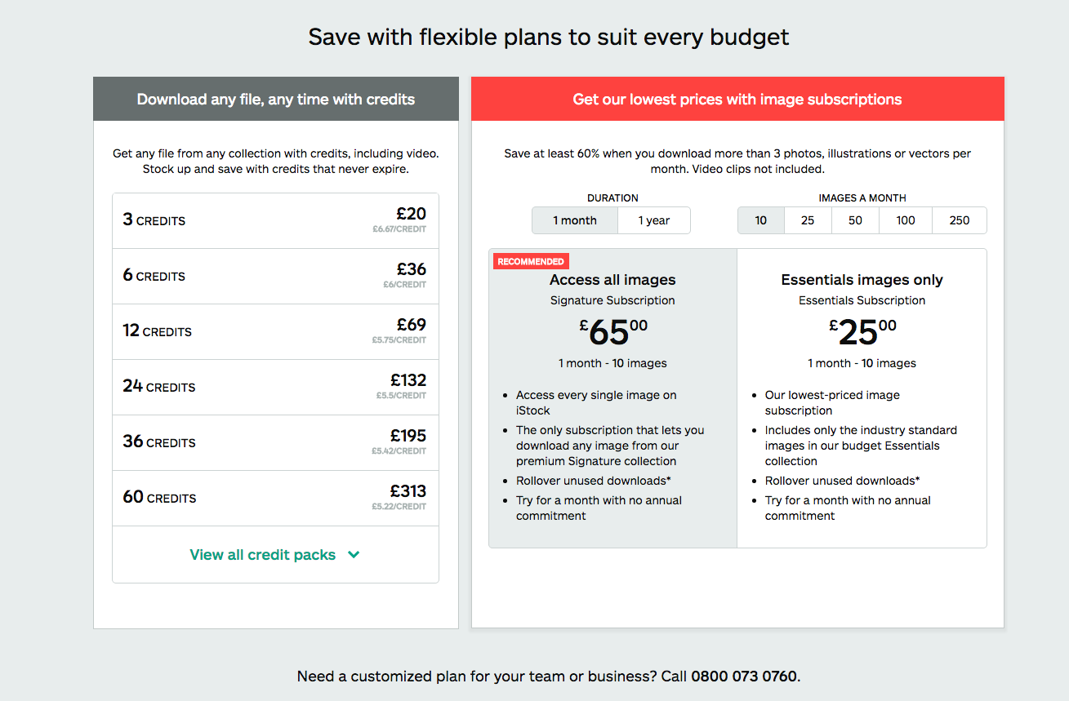

Slide 9
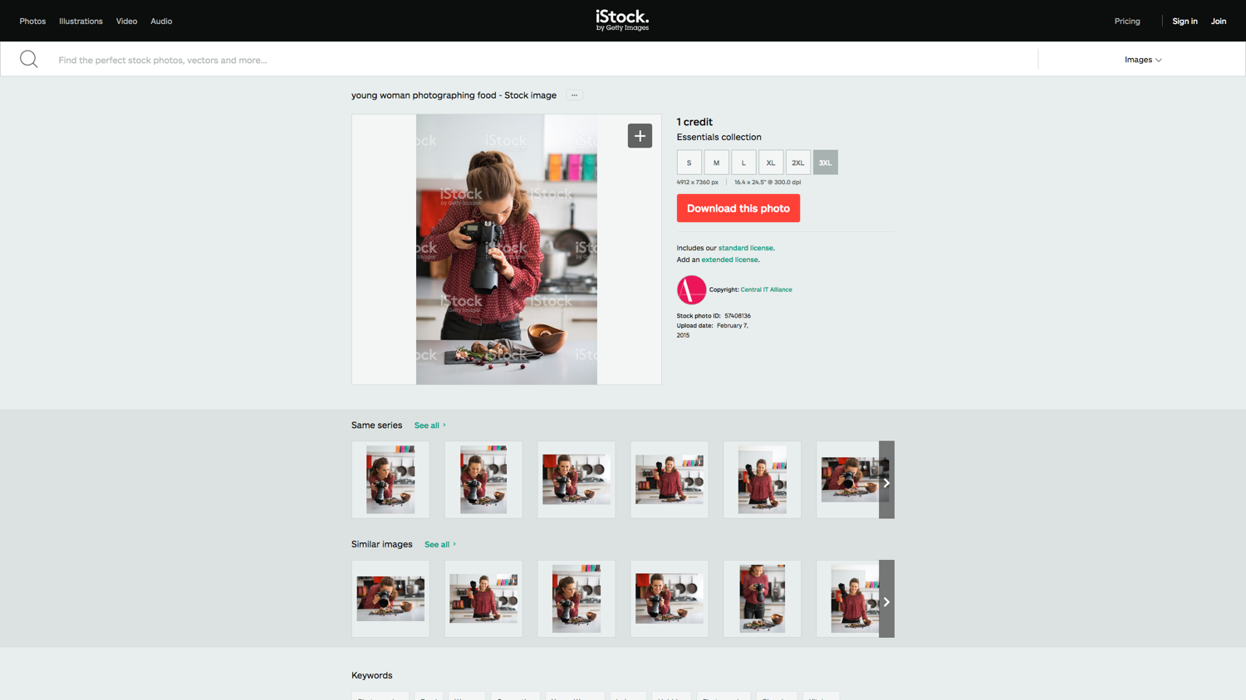

Slide 10

4. Image is Public Domain or Creative Commons
You must endear to any restrictions contained within the type of Creative Commons license the image has been released under.
http://creativecommons.org/about
http://creativecommons.org/licenses/
http://search.creativecommons.org/
http://commons.wikimedia.org/wiki/Commons:Featured_pictures
http://www.flickr.com/commons
Notes:
Creative commons licenses offer a range of options to distribute design work.

Slide 11

Creative Commons - Licensing types
CREATIVECOMMONS.ORG, 2016. Licensing types [viewed 27 August 2016]. Available from: https://creativecommons.org/share-your-work/licensing-types-examples/

Slide 12
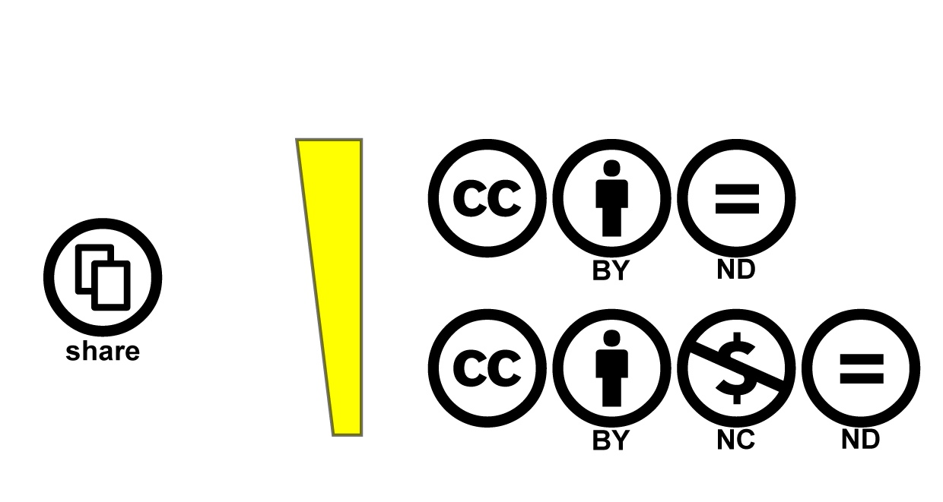
Creative Commons - Licensing types
CREATIVECOMMONS.ORG, 2016. Licensing types [viewed 27 August 2016]. Available from: https://creativecommons.org/share-your-work/licensing-types-examples/

Slide 13
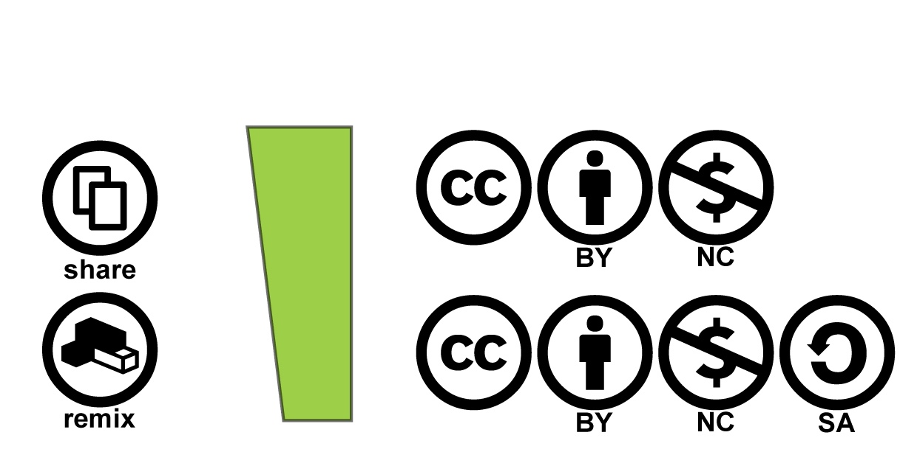
Creative Commons - Licensing types
CREATIVECOMMONS.ORG, 2016. Licensing types [viewed 27 August 2016]. Available from: https://creativecommons.org/share-your-work/licensing-types-examples/

Slide 14
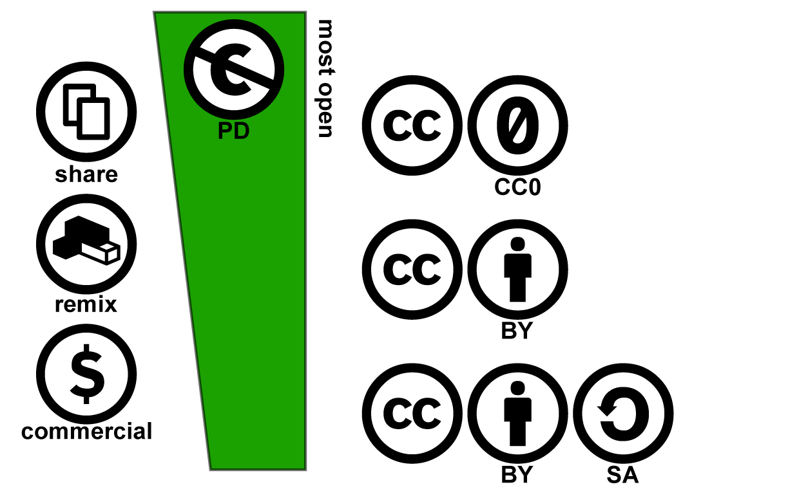
CREATIVECOMMONS.ORG, 2016. Licensing types [viewed 27 August 2016]. Available from: https://creativecommons.org/share-your-work/licensing-types-examples/

Slide 15
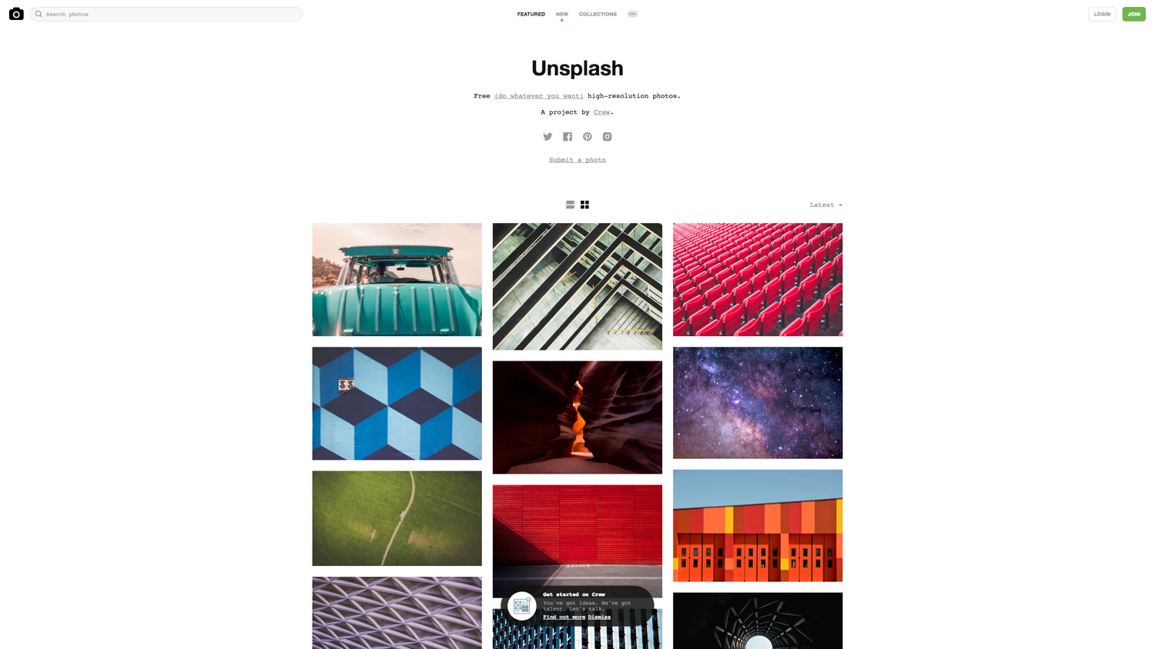
unsplash.com
Notes:
The whole number of websites that offer CC0 (public domain) photographs to use in your design concepts

Slide 16

fakecrow.com/17-best-stock-image-icon-uidesign-sources/

Slide 17
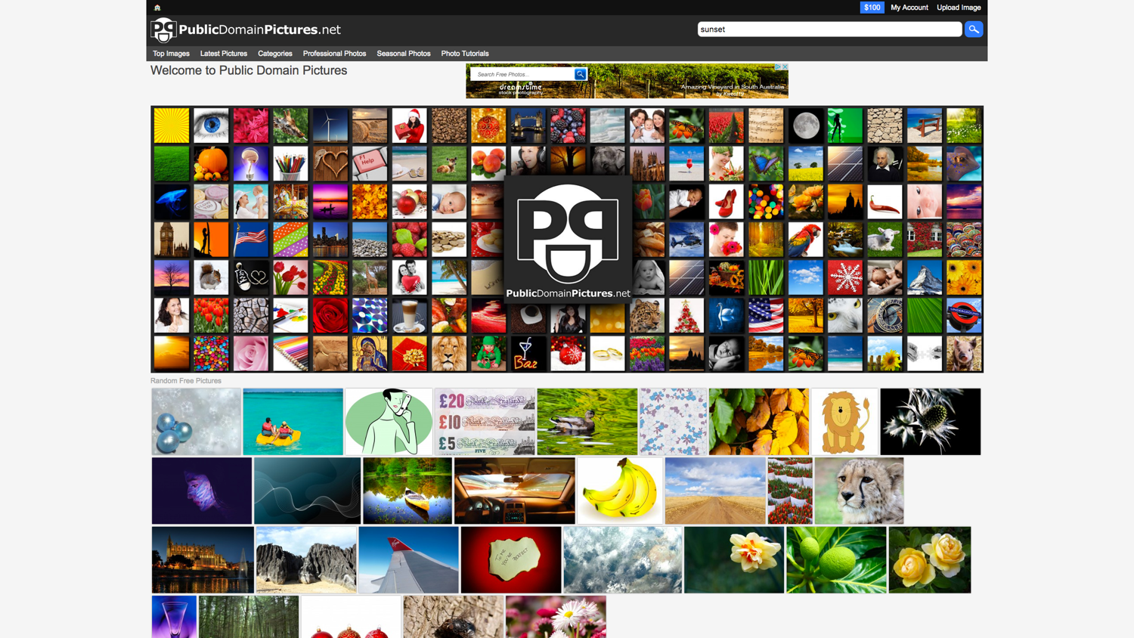
publicdomainpictures.net

Slide 18
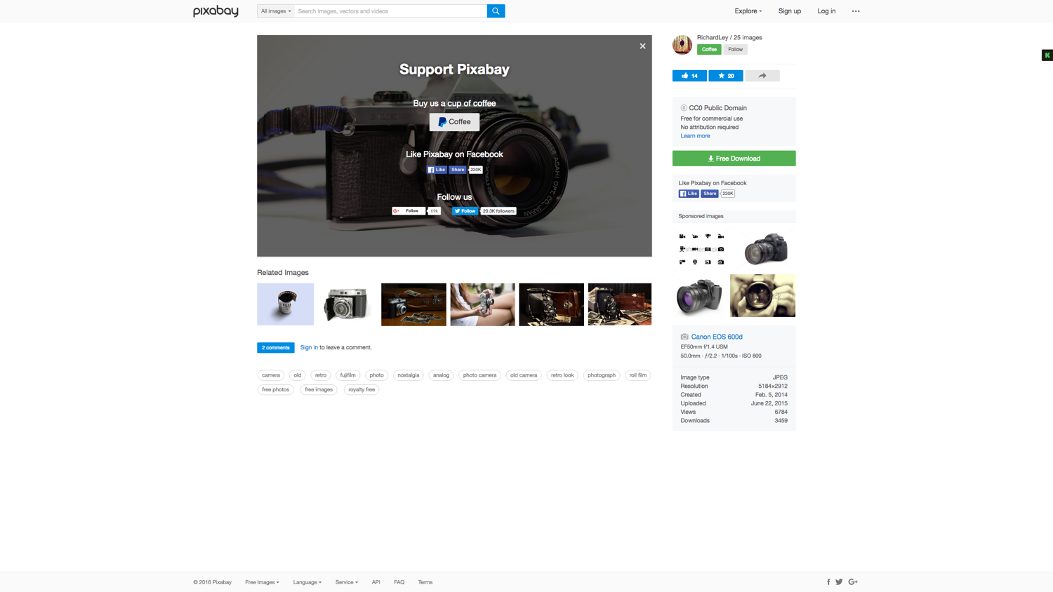
pixabay.com

Slide 19

5. The image is presented as “fair use”
This covers academic use, use in teaching, research journalistic work, reviews and criticism. Although this can a “grey area” legally.
http://fairuse.stanford.edu/
http://www.copyrightservice.co.uk/copyright/p09_fair_use
http://www.copyrightservice.co.uk/copyright/p27_work_of_others#fair_dealing
http://www15.uta.fi/FAST/PK6/REF/fairuse.html

Slide 20

Remember to avoid passing off somebody else’s work as your own within your assignments; either intentionally or unintentionally.
Always reference image sources in the Harvard style using the figure list system.

Slide 21
Final Overview
Do not use images from a Google search
Create your own images
Use Creative Commons or public domain.
Use low resolution composite (comps) stock libraries
You can use somebody else’s work within your assignments under the “fair use” of the copyright.
Always reference the source

Slide 22
Image reference structure & styling
Best approach is to have a “List of Figures” section.
They should be consecutively numbered eg: (Figure 1) (Figure 2) (Figure 3)
It appears after the Contents Page within a report
The List of Figures must have a description and source set out in the Harvard style

